Slide 1

Data Structures Using C++ 2E
Chapter 9
Searching and Hashing Algorithms
Updated in December 2020

Slide 2
Objectives
Learn the various search algorithms
Explore the sequential and binary search algorithms
Discover how the sequential and binary search algorithms perform
Learn about hashing
Data Structures Using C++ 2E

Slide 3
Search Algorithms
Item key
  Unique member of the item
  Used in searching, sorting, insertion, deletion
Number of key comparisons
  Comparing the key of the search item with the key of an item in the list
  Example: Phone directory – given a name, find the phone number
Can be used to search items inside of Arrays and Lists
Data Structures Using C++ 2E

Slide 4
Sequential Search
Begin at one end of the array or linked list and scan down until desired key is found or end of the list is reached
Data Structures Using C++ 2E

Slide 5
Efficiency
Time required to code the algorithm
Time required for execution
Amount of memory space required
When we talk about efficiency of an algorithm, we usually talk about the time required for execution for the worst case of the algorithm.
Data Structures Using C++ 2E

Slide 6
O-Notation Order of Magnitude (Big-O)
The order of magnitude of a function is identified with the term in the function that increases the fastest relative to the size of the problem.
Example: f(n) = n⁴ + 100n² + 10n + 50
the f(n) is of order O(n⁴)
Data Structures Using C++ 2E

Slide 7
O-Notation Cont.
For the following algorithm:
  Open a file
  While more elements are in the array
    -print the element onto the file
If n is the number of elements in the array, what is the Big-O of the algorithm?
    Big-O of the algorithm is 1 + n*1 → O(n)
Data Structures Using C++ 2E

Slide 8
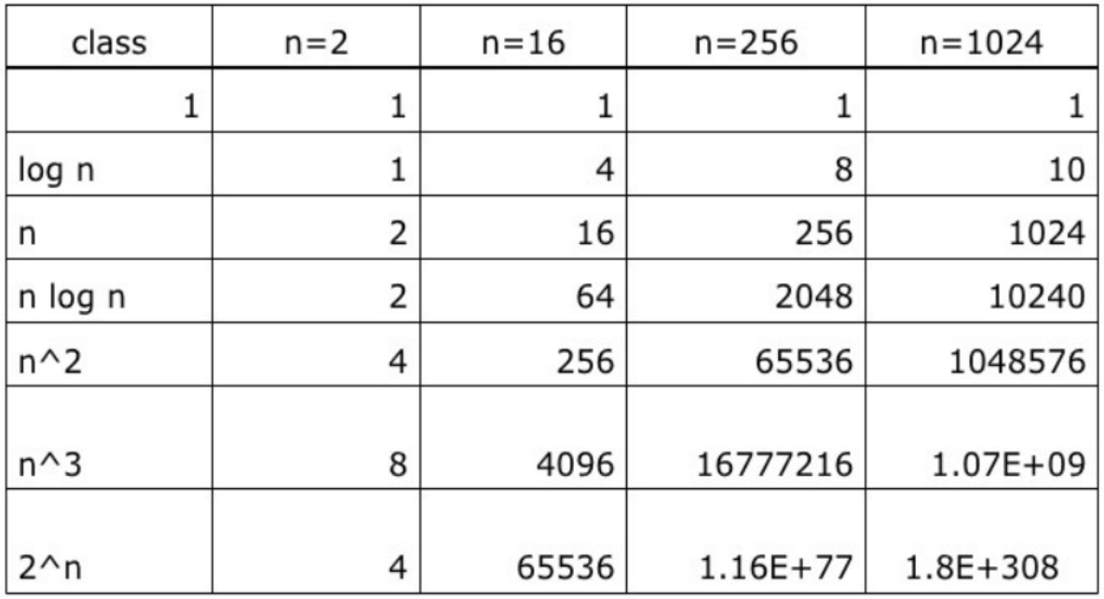
Common Orders of Magnitude
Data Structures Using C++ 2E

Slide 9
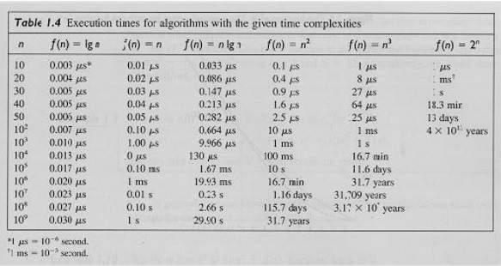
Common Orders of Magnitude
Data Structures Using C++ 2E

Slide 10
Sequential Search Analysis
Different programmers might implement same algorithm differently
Computer speed affects performance
Big-O of the algorithm does not chance with the computer speed
Data Structures Using C++ 2E

Slide 11
Sequential Search Analysis (cont’d.)
Sequential search algorithm performance
  Examine worst case and average case
  Count number of key comparisons
Unsuccessful search
  Search item not in list
  Make n comparisons
Conducting algorithm performance analysis
  Best case: make one key comparison
  Worst case: algorithm makes n comparisons
Data Structures Using C++ 2E

Slide 12
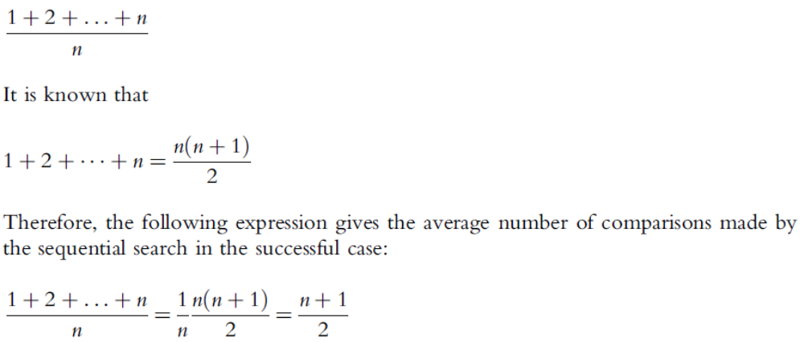
Sequential Search Analysis (cont’d.)
Determining the average number of comparisons (cont’d.)
Data Structures Using C++ 2E

Slide 13
Big-O of Sequential Search
Efficiency of the Sequential Search is O(n)
Efficiency calculations are always based on the worst cases.
Best cases and average cases are mostly ignored
Data Structures Using C++ 2E

Slide 14
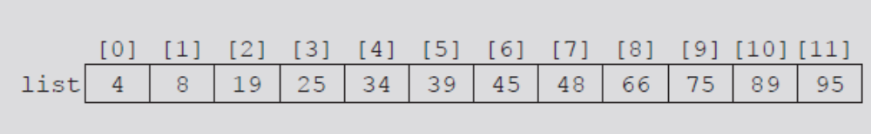
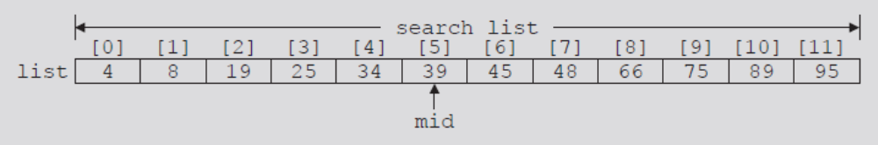
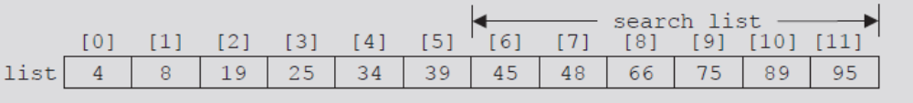
Binary Search
Performed only on ordered lists
Uses divide-and-conquer technique
FIGURE 9-1 List of length 12
FIGURE 9-2 Search list, list[0]...list[11]
FIGURE 9-3 Search list, list[6]...list[11]
Data Structures Using C++ 2E

Slide 15
Binary Search
This is the divide and conquer approach. The searched key is compared with the key in the middle of the ordered list, if not equal, the upper or lower half of the list are searched according to the value of the key.
Searching for 38
0 1 2 3 4 5 6
list 11 12 14 22 29 36 44
The efficiency of the Binary Search algorithm is O(log₂ n)
Data Structures Using C++ 2E

Slide 16
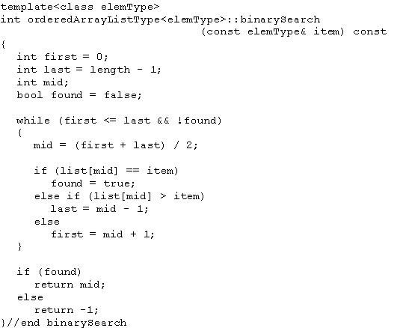
Binary Search Example Code
C++ function implementing binary search algorithm
Data Structures Using C++ 2E

Slide 17

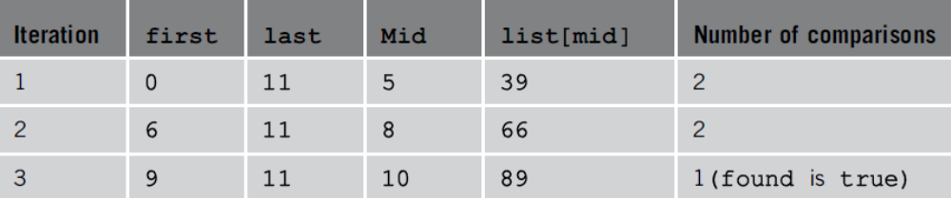
Binary Search (cont’d.)
Example 9-1
FIGURE 9-4 Sorted list for a binary search
TABLE 9-1 Values of first, last, and mid and the number of comparisons for search item 89
Data Structures Using C++ 2E

Slide 18
Binary Search Example
searching for 14
0 1 2 3 4 5 6
list 11 12 14 22 29 36 44
Data Structures Using C++ 2E

Slide 19
Lower Bound on Comparison-Based Search Algorithms
Comparison-based search algorithms
  Search list by comparing target element with list elements
Sequential search: order n
Binary search: order log₂n
Data Structures Using C++ 2E

Slide 20
Hashing
Algorithm is of Big-O one (on average)
Requires data to be specially organized
  Hash table
    Helps organize data
    Stored in an array
    Denoted by HT
  Hash function
    Arithmetic function denoted by h
    Applied to key X
    Compute h(X): read as h of X
    h(X) gives address of the item
Data Structures Using C++ 2E

Slide 21
Hashing (cont’d.)
Organizing data in the hash table
  Store data within the hash table (array)
  Store data in linked lists
Hash table HT divided into b buckets
  HT[0], HT[1], . . ., HT[b – 1]
  Each bucket capable of holding r items
  Follows that br = m, where m is the size of HT
  Generally r = 1
    Each bucket can hold one item
The hash function h maps key X onto an integer t
  h(X) = t, such that 0 <= h(X) <= b – 1
Data Structures Using C++ 2E

Slide 22
Hashing Example
0 1 2 3 4 n
[2005 Beril | 19876 Özlem | 6652 Emre | 1238 Ali | 233 faruk | ....]
h = mod 5(num)
1238 % 5 = 3
233 % 5 = 3
this is a collision
will use the collision resolution algorithm to fix this problem
Data Structures Using C++ 2E

Slide 23
Hashing (cont’d.)
See Examples 9-2 and 9-3
Synonym
  Occurs if h(X₁) = h(X₂)
    Given two keys X₁ and X₂, such that X₁ ≠ X₂
Overflow
  Occurs if bucket t full
Collision
  Occurs if h(X₁) = h(X₂)
    Given X₁ and X₂ nonidentical keys
Data Structures Using C++ 2E

Slide 24
Hashing (cont’d.)
Overflow and collision occur at same time
  If r = 1 (bucket size = one)
Choosing a hash function
  Main objectives
    Choose an easy to compute hash function
    Minimize number of collisions
If HTSize denotes the size of hash table (array size holding the hash table)
  Assume bucket size = one
    Each bucket can hold one item
    Overflow and collision occur simultaneously
Data Structures Using C++ 2E

Slide 25
Hash Functions: Some Examples
Mid-square
Folding
Division (modular arithmetic)
Custom Arithmetic Functions
Data Structures Using C++ 2E

Slide 26
Mid Square
Key is multiplied by itself. Hash function returns some of the middle digits of the result
e.g: Key is 6185
Table size is 100. (We need to pick 2 digits 0-99)
6185 x 6185 = 382 54 225
result is 54.
Data Structures Using C++ 2E

Slide 27
Folding
Partition the key into several parts and combine them in a convenient way.
e.g: Key is 62538194
table size is 1000
625 381 94
625 + 381 + 94 = 1100
1100 % 1000 = 100
result is 100.
Data Structures Using C++ 2E

Slide 28
Modular Arithmetic
Convert the key into an integer, divide by the size of the array, take the reminder.
It is a good idea to pick a table size that is prime number to reduce possible collisions.
h(x) = key % tablesize
key is 689765
table size is 997
h(689765) = 689765 % 997 = 838
Data Structures Using C++ 2E

Slide 29
Custom Arithmetic Function
You can choose any arithmetic set of operations as a hash function.
e.g: Sum of all digits is the function, table size =10
1000000023 = 6
3378 = 21 % 10 = 1
501 = 6 causes a collision
Data Structures Using C++ 2E

Slide 30
Collision Resolution
Desirable to minimize number of collisions
  Collisions unavoidable in reality
    Hash function always maps a larger domain onto a smaller range
Collision resolution technique categories
  Open addressing (closed hashing)
    Data stored within the hash table
  Chaining (open hashing)
    Data organized in linked lists
    Hash table: array of pointers to the linked lists
Data Structures Using C++ 2E

Slide 31
Collision Resolution: Open Addressing
Data stored within the hash table
  Linear Probing
  Quadratic Probing
  Rehashing
Data Structures Using C++ 2E

Slide 32
Linear Probing
Starting at location t
  Search array sequentially to find next available slot
Assume circular array
  If lower portion of array full
    Can continue search in top portion of array using mod operator
  Starting at t, check array locations using probe sequence
    t, (t + 1) % HTSize, (t + 2) % HTSize, . . ., (t + j) % HTSize
Data Structures Using C++ 2E

Slide 33
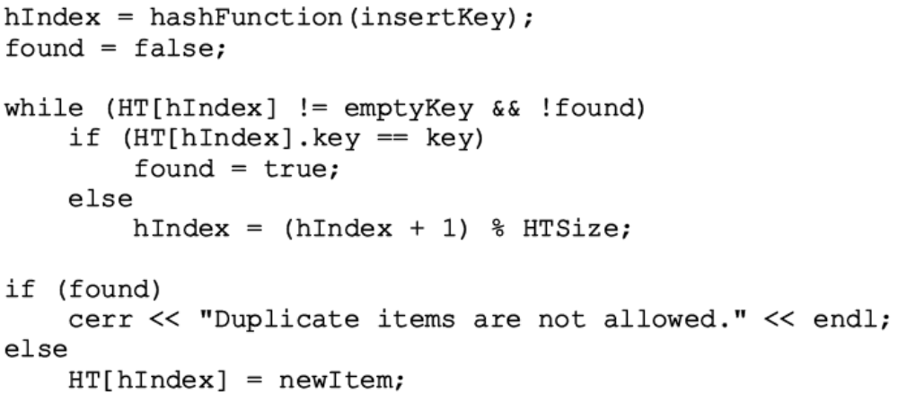
Linear Probing (cont’d.)
The next array slot is given by
  (h(X) + j) % HTSize where j is the j^{th} probe
See Example 9-4
C++ code implementing linear programming
Data Structures Using C++ 2E

Slide 34

Linear Probing (cont’d.)
Causes clustering
  More and more new keys would likely be hashed to the array slots already occupied
FIGURE 9-5 Hash table of size 20
FIGURE 9-6 Hash table of size 20 with certain positions occupied
FIGURE 9-7 Hash table of size 20 with certain positions occupied
Data Structures Using C++ 2E

Slide 35

Linear Probing (cont’d.)
Improving linear probing
  Skip array positions by fixed constant (c) instead of one
  New hash address:
    If c = 2 and h(X) = 2k (h(X) even)
      Only even-numbered array positions visited
    If c = 2 and h(X) = 2k + 1, ( h(X) odd)
      Only odd-numbered array positions visited
    To visit all the array positions
      Constant c must be relatively prime to HTSize
Data Structures Using C++ 2E

Slide 36
Random Probing
Uses random number generator to find next available slot
  i^{th} slot in probe sequence: (h(X) + r_{i}) % HTSize
    Where r_{i} is the i^{th} value in a random permutation of the numbers 1 to HTSize – 1
  All insertions, searches use same random numbers sequence
See Example 9-5
Data Structures Using C++ 2E

Slide 37
Rehashing
If collision occurs with hash function h
  Use a series of hash functions: h₁, h₂, . . ., h_{s}
  If collision occurs at h(X)
    Array slots h_{i}(X), 1 <= h_{i}(X) <= s examined
Data Structures Using C++ 2E

Slide 38
Quadratic Probing
Suppose
  Item with key X hashed at t (h(X) = t and 0 <= t <= HTSize – 1)
  Position t already occupied
Starting at position t
  Linearly search array at locations (t + 1)% HTSize, (t + 2² ) % HTSize = (t + 4) %HTSize, (t + 3²) % HTSize = (t + 9) % HTSize, . . ., (t + i²) % HTSize
Probe sequence: t, (t + 1) % HTSize (t + 2² ) % HTSize, (t + 3²) % HTSize, . . ., (t + i²) % HTSize
Data Structures Using C++ 2E

Slide 39
Quadratic Probing (cont’d.)
See Example 9-6
Reduces primary clustering
Does not probe all positions in the table
  Probes about half the table before repeating probe sequence
    When HTSize is a prime
  Considerable number of probes
    Assume full table
    Stop insertion (and search)
Data Structures Using C++ 2E

Slide 40
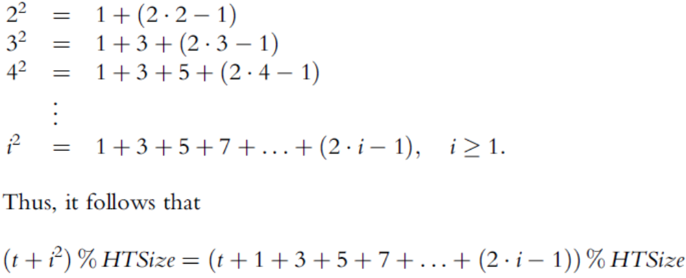
Quadratic Probing (cont’d.)
Generating the probe sequence
Data Structures Using C++ 2E

Slide 41
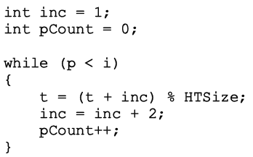
Quadratic Probing (cont’d.)
Consider probe sequence
  t, t +1, t + 2², t + 3², . . . , (t + i²) % HTSize
  C++ code computes i^{th} probe
    (t + i²) % HTSize
Data Structures Using C++ 2E

Slide 42
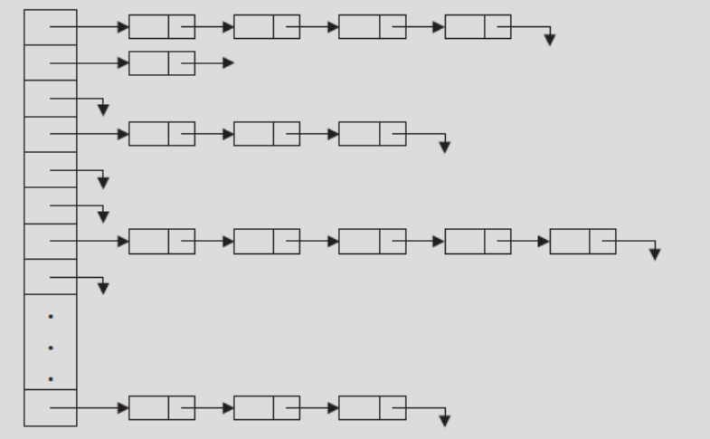
Collision Resolution: Chaining
Hash table HT: array of pointers
  For each j, where 0 <= j <= HTsize -1
    HT[j] is a pointer to a linked list
    Hash table size (HTSize): less than or equal to the number of items
FIGURE 9-10 Linked hash table
Data Structures Using C++ 2E

Slide 43
Collision Resolution: Chaining (cont’d.)
Item insertion and collision
  For each key X (in the item)
    First find h(X) – t, where 0 <= t <= HTSize – 1
    Item with this key inserted in linked list pointed to by HT[t]
  For nonidentical keys X₁ and X₂
    If h(X₁) = h(X₂)
      Items with keys X₁ and X₂ inserted in same linked list
    Collision handled quickly, effectively
Data Structures Using C++ 2E

Slide 44
Collision Resolution: Chaining (cont’d.)
Search
  Determine whether item R with key X is in the hash table
    First calculate h(X)
  Example: h(X) = T
    Linked list pointed to by HT[t] searched sequentially
Deletion
  Delete item R from the hash table
    Search hash table to find where in a linked list R exists
    Adjust pointers at appropriate locations
    Deallocate memory occupied by R
Data Structures Using C++ 2E

Slide 45
Collision Resolution: Chaining (cont’d.)
Overflow
  No longer a concern
    Data stored in linked lists
    Memory space to store data allocated dynamically
  Hash table size
    No longer needs to be greater than number of items
  Hash table less than the number of items
    Some linked lists contain more than one item
    Good hash function has average linked list length still small (search is efficient)
Data Structures Using C++ 2E

Slide 46
Collision Resolution: Chaining (cont’d.)
Advantages of chaining
  Item insertion and deletion: straightforward
  Efficient hash function
    Few keys hashed to same home position
    Short linked list (on average)
      Shorter search length
    If item size is large
      Saves a considerable amount of space
Data Structures Using C++ 2E

Slide 47
Collision Resolution: Chaining (cont’d.)
Disadvantage of chaining
  Small item size wastes space
Example: 1000 items each requires one word of storage
  Chaining
    Requires 3000 words of storage
  Quadratic probing
    If hash table size twice number of items: 2000 words
    If table size three times number of items
      Keys reasonably spread out
      Results in fewer collisions
Data Structures Using C++ 2E

